Slide 1
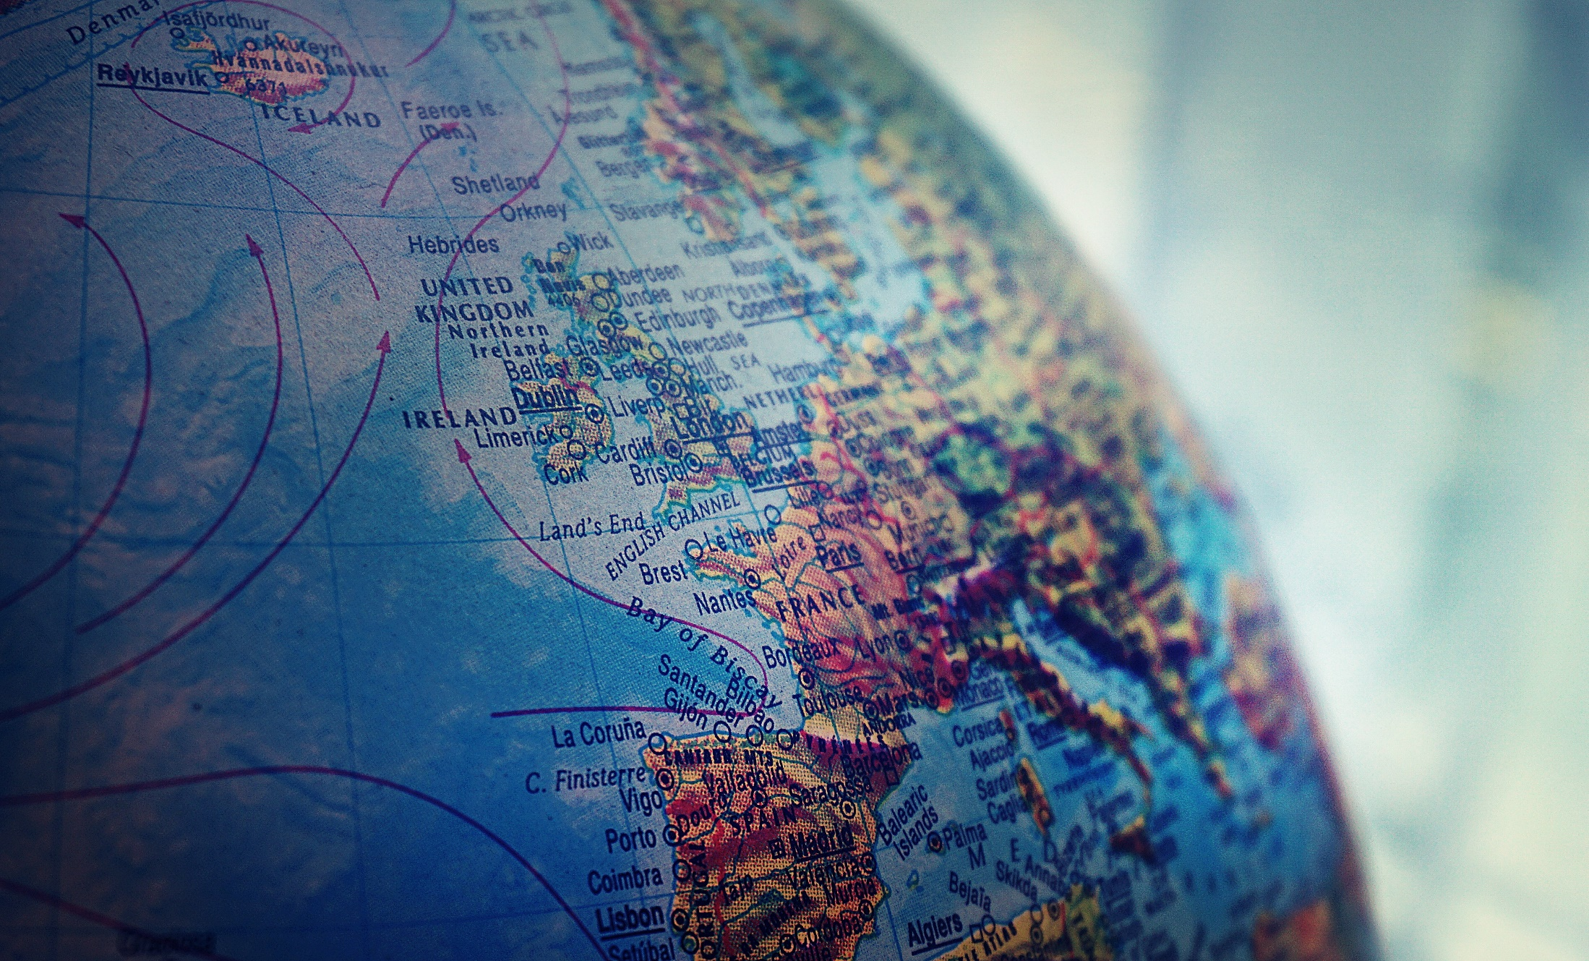
Advancing the Kingdom of God
The Outpouring of God in Uncertain Times

Slide 2
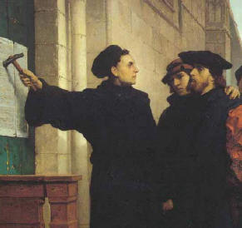
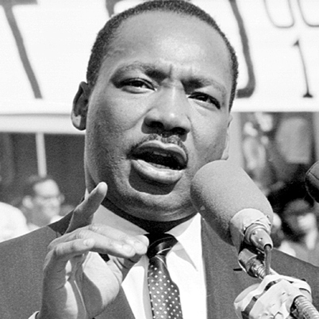
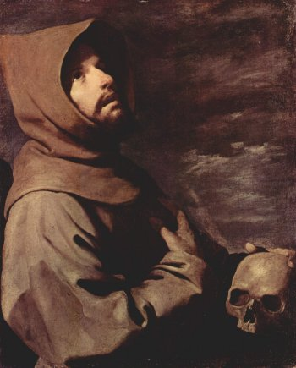
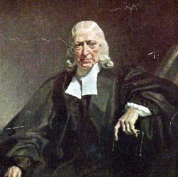
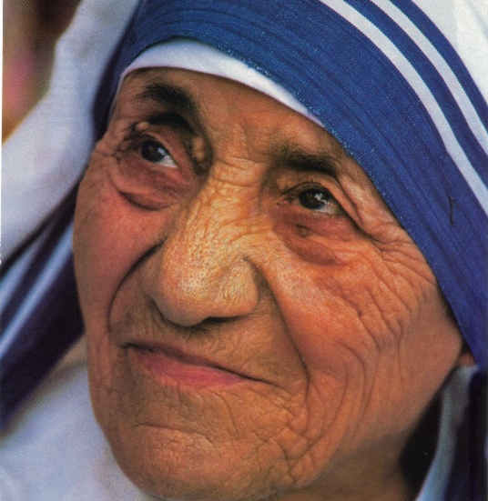
Notes:
In the Middle Ages, God spoke to a young man in the Italian city of Assisi about “repairing my church.” Francis of Assisi went on to become a leader of one of the most significant monastic orders in the Catholic Church. The impact of Francis’ words and life echo through the centuries and influence people today. In the sixteenth century, the world was changed by the Protestant Reformation started by Martin Luther, a young priest in a small corner of Germany. A couple of centuries later, England was spared from a bloody peasant revolution by the Evangelical revival ushered in by John and Charles Wesley.
In the last century, a preacher from the Southern region of the United States, Dr. Martin Luther King, Jr. “had a dream” and the movement he started helped change the face of a nation and shape the thinking of the modern world. Also, in the last century, a small Albanian woman, known as Mother Teresa, touched the lives of countless poor men, women, and children, setting an example to serve those in need and alleviate suﬀering around the world.
Each of these men and women were history makers in their own time. Some had a global impact while others fostered less broad—but by no means less important—changes. The common factor in these and many other examples of events and movements is a leader with a vision, a dream, and a plan. As a result, he or she led others in a movement that brought transformation and ultimately changed the course of history.

Slide 3
Thy Kingdom Come
Thy Will Be Done
On Earth
As It Is in Heaven
Matthew 6:10

Slide 4
WHAT IS THE KINGDOM OF GOD?
The rule and reign of God, both now and in the future.
It is the realm where God’s will is done and God’s authority is acknowledged and obeyed.

Slide 5
God's Reign and Rule
The core idea of the Kingdom of God is God's sovereignty and his active rule over his creation. It signifies a reality where God's will is supreme and his purposes are fulfilled.

Slide 6
Present and Future Reality
The Kingdom of God is not just a future hope, but also a present reality that can be experienced now through faith and obedience to God's will. Jesus' teachings emphasize the arrival of God's Kingdom, and believers are called to participate in it by aligning their lives with God's purposes.

Slide 7
Within Individuals and the World
The Kingdom of God can be understood in different ways: as a personal transformation within individuals, as a community of believers living out God's will, and as a future hope for the complete establishment of God's reign on earth.

Slide 8
Key Themes in Jesus' Teachings
The Kingdom of God is a central theme in Jesus' teachings, often described through parables and illustrations that highlight its nature and significance. Examples include the mustard seed and the leaven, which illustrate the Kingdom's growth and influence.

Slide 9
The Great Decline
!
A Large and Fast Shift Away from the Christian Faith

Slide 10

A Dramatic Shift
Belief in Jesus Rises

Slide 11
Barna Research (USA)
April 2025
!!!
Commitment to Christ is Rising Among Gen Z Men by 15 percentage points

Slide 12
Western Europe
!!!
Gen Z goes to church more than Boomers, Germany (+28%)
U.K. (+22%)
France (+21%)

Slide 13
Bible Society
!!!
  Among 18-24 year olds, the attendance monthly
    2018: 4%
    2024: 16%
  Among 25-34 year olds:
    2018: 4%
    2024: 13%

Slide 14
Lausanne
2025
!!!
Gen Z recognized as the next generation to be advancing the gospel and faithfully address the challenges confronting the global church.
Notes:
THE MISSION
A second key question emerged as ILI’s founding leaders prayed and asked for God’s guidance:
What are the qualities of Christian leaders who are changing history?
Identifying these unique facets of their faith, thinking, skills sets, and actions could potentially change history if these attributes were multiplied in the lives of others.

Slide 15


Outbreaks of Spiritual Fire
The Asbury Revival

Slide 16
Personal Holiness
You will seek me and fine Me, when you seek Me with ALL your heart.
Jeremiah 29:13

Slide 17
Individual Transformational
Be transformed by the renewing of your mind, so that you may prove what the will of God is, that which is good and acceptable and perfect. Romans 12:2

Slide 18
Reach the Lost
For the Son of Man has come to seek and save the lost that which is lost
Luke 19:10

Slide 19

GOD´S PASSION REMAINS UNCHANGED
UNTIL ALL ARE REACHED, WE ARE COMMANDED TO…
+5 BILLION
STILL NEED CHRIST
Notes:
Christ’s sacrifice was sufficient and targeted at men and women from every nation of the world.
More than five billion people—two-thirds of the world’s population—still need to be reached with the life-transforming power of the Gospel. As Christians, we are commanded to…

Slide 20
Go and Make Disciples
Go and make disciples of all nations.
Matthew 28:19

Slide 21
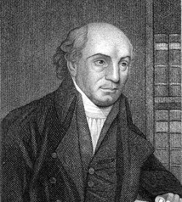
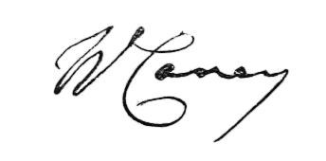
Expect great things from God.
Attempt great things for God.
WILLIAM CAREY
Notes:
CONCLUSION
William Carey was a humble shoemaker and lay leader in seventeenth-century England. He answered the call of God to take the Gospel to India despite great opposition from his peers and superiors. Today, Carey is known as “the father of modern missions.” His lifetime of Christian service changed history. May his words below serve as inspiration for this training and your leadership.
“Expect great things from God. Attempt great things for God.”

