Slide 1


BIBLICAL
LEADERSHIP
Advancing the Kingdom of God

Slide 2
THE IMPORTANCE OF LEADERSHIP
MAKE or BREAK
ADVANCE or DESTROY
EMPOWER or STAGNATE
LEAD THE WAY or LOSE THE WAY

Slide 3

BIBLICAL FOUNDATION
I will make you a GREAT NATION
ABRAHAM
Notes:
BIBLICAL FOUNDATION
The Bible provides many case studies in leadership. In fact, the biblical pattern is that “God changes the course of history through the selection of men and women who will act on His behalf.”² Below are some examples of how God used men and women to execute His will in Scriptures.
ABRAHAM (Gen. 12:1–3). God called him to be the father of a great nation through which the Savior would come.

Slide 4


BIBLICAL FOUNDATION
I am sending you back to BRING MY PEOPLE OUT OF CAPTIVITY
MOSES
Notes:
BIBLICAL FOUNDATION
MOSES (Exod. 3:8–10). God called Moses to be the deliverer and leader of His people when they were slaves in Egypt.

Slide 5

BIBLICAL FOUNDATION
I am anointing you KING over Israel
DAVID
Notes:
BIBLICAL FOUNDATION
DAVID (1 Sam. 13:14). God called and anointed David to be the king who would unite the nation of Israel and lead it to prosperity.

Slide 6

BIBLICAL FOUNDATION
I will use you to PROTECT my people
ESTHER
Notes:
BIBLICAL FOUNDATION
ESTHER (Esther 4:14). God positioned Esther as queen and called her to preserve the Jewish nation when they were threatened with genocide in the Persian Empire.

Slide 7

BIBLICAL FOUNDATION
I will use ordinary people to SHARE my message
DISCIPLES
Notes:
BIBLICAL FOUNDATION
THE DISCIPLES. The Gospels tell us of 12 very ordinary men who were called by Jesus to spread His message after His ascension.

Slide 8
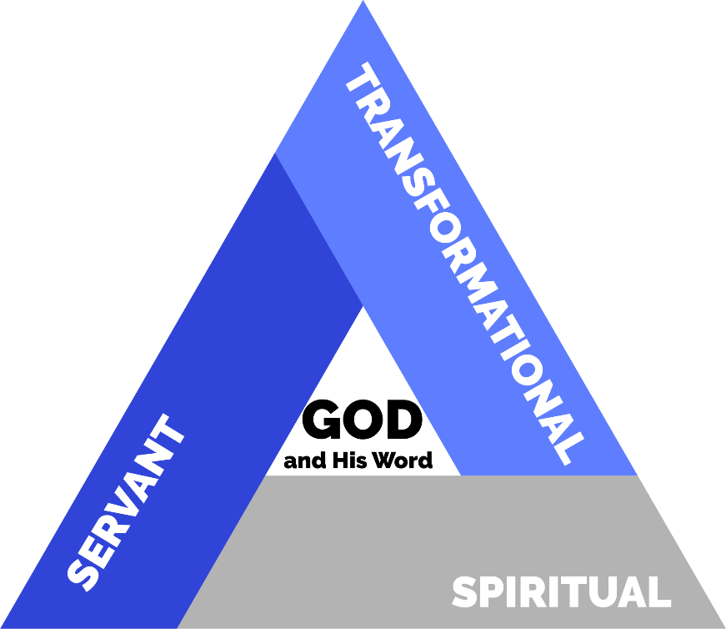
THE BIBLICAL LEADERSHIP TRIANGLE
Notes:
THE BIBLICAL LEADERSHIP TRIANGLE
Biblical leadership is best represented by the image of an equilateral triangle—a triangle in which all sides have the same length. This triangle is a symbol of strength and stability. The three sides represent essential characteristics of biblical leaders. The triangle’s sides are the same size, meaning the three aspects of biblical leadership have the same weight and importance in the life of the biblical leader.
SPIRITUAL LEADERSHIP
Biblical leadership is spiritual in nature. It originates in God and is centered in Him.
SERVANT LEADERSHIP
Biblical leadership is focused on others and oriented toward service. Jesus is the supreme model of true servant leadership.
TRANSFORMATIONAL LEADERSHIP
Biblical leadership is aimed at meaningful change. Transformational leaders change themselves, their followers, and their world.
For a biblical leader to reach his or her full potential and achieve peak performance, all three characteristics must be present and increasing.

Slide 9

SPIRITUAL LEADERSHIP
Notes:
SPIRITUAL LEADERSHIP
In the natural world, leadership is exercised based on human ability and skills. Spiritual leadership does not discard natural abilities, but is the result of blending a person’s natural and spiritual qualities in the service of God and for His glory.
Oswald Sanders states, “The spiritual leader influences others not by the power of his own personality but by that personality initiated and interpenetrated and empowered by the Holy Spirit.”
Spiritual leadership is based on the Word of God and exercised in the power of the Holy Spirit.
SPIRITUAL LEADERSHIP IN THE LIFE OF MOSES
Moses is an excellent biblical example of spiritual leadership. If we take a closer look at his career as Israel’s deliverer, we see four essential aspects of spiritual leadership.

Slide 10

ORIGINATES IN GOD
When the LORD saw that he had gone over to look, God called to him from within the bush, “Moses, Moses!” And Moses said “Here I am.”
Exodus 3:4
Notes:
SPIRITUAL LEADERSHIP ORIGINATES IN GOD
When Moses sought to lead the people from his own strength, he failed miserably (Exodus 2:14). Forty years later, when he was not seeking a position of leadership, God called him. The vision of delivering God’s people from captivity and establishing them in the Promised Land also originated in God.
When the LORD saw that he had gone over to look, God called to him from within the bush, “Moses! Moses!” And Moses said “Here I am.” — Exodus 3:4

Slide 11

AUTHORITY
FROM GOD
Moses took his wife and sons, put them back on a donkey and started back to Egypt. And he took the staff of God in his hand.
Exodus 4:20
Notes:
SPIRITUAL LEADERSHIP IS EXERCISED WITH AUTHORITY FROM GOD
The fundamental diﬀerence from Moses’ attempt to lead before he spent forty years in the desert was the source of his authority after God called him from the burning bush.
So Moses took his wife and sons, put them on a donkey and started back to Egypt. And he took the staff of God in his hand. —Exodus 4:20
The staﬀ of God was the instrument by which God displayed His power to Moses, to the Israelites, and to the court of Pharaoh. Moses held it for the rest of his life, and it represented God’s authority that came from God’s calling.

Slide 12

REFLECTS THE CHARACTER OF GOD
Now Moses was a very humble man, more humble than anyone else on the face of the earth. Numbers 12:3
Notes:
SPIRITUAL LEADERSHIP REFLECTS THE CHARACTER OF GOD
As Moses continued to exercise spiritual leadership, he grew more intimate with God and reflected His character.
Now Moses was a very humble man, more humble than anyone else on the face of the earth. —Numbers 12:3
This particular aspect of spiritual leadership took longer to manifest in Moses and was the result of a long-term relationship of intimacy with God.

Slide 13
NATURAL & SPIRITUAL LEADERS
NATURAL | SPIRITUAL
Self-Confident | Places Confidence in God
Knows People | Also Knows God
Decision-Making Skills | Decides Based on God’s Will
Ambitious | Proactive, Yet Humble
Notes:
NATURAL AND SPIRITUAL LEADERS
One of the most asked questions in leadership is whether leaders are born or made. In other words, are leadership traits natural or acquired? The answer is that while there are natural personality traits that facilitate leadership, the skills and abilities necessary for the exercise of leadership are learned over the course of the leader’s life.
Natural and spiritual leaders have God-given personality traits and acquired abilities to lead others and accomplish the vision. Spiritual leaders also have added skills given by the Holy Spirit. A comparison chart between natural and spiritual leaders includes the following⁴:

Slide 14
NATURAL & SPIRITUAL LEADERS
NATURAL | SPIRITUAL
Creates Methods | Finds & Follows God´s Methods
Command and Control or Democatic | Leads in Obedience to God
Motivated by Personal Considerations | Motivated by Love for God and People
Independent | God-Dependent

Slide 15

THE LEADERSHIP TRIANGLE

Slide 16


SERVANT LEADERSHIP

Slide 17
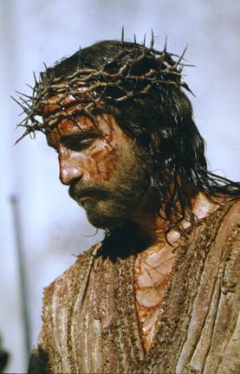
BIBLICAL MODEL
… Who, being in very nature God, did not consider equality with God something to be used to His own advantage; rather, He made himself nothing by taking the very nature of a servant…. Philippians 2:6-7
TRANSFORMATIONAL BEHAVIORS
Notes:
SERVANT LEADERSHIP DEFINED
Although this model has become popular only recently, two thousand years ago, Jesus left the glory of His heavenly throne and assumed the position of a servant on our behalf.
Who, being in very nature God, did not consider equality with God something to be used to his own advantage; rather, He made Himself nothing by taking the very nature of a servant. —Philippians 2:6–7, TNIV

Slide 18

BIBLICAL MODEL
And whosoever
would be first among you, shall be servant of all.
Mark 10: 44 ASV
TRANSFORMATIONAL BEHAVIORS
Notes:
SERVANT LEADERSHIP DEFINED
Jesus led through service and thus provided His disciples with a model of leadership based on service to God and to others. He said,
And whosoever would be first among you, shall be servant of all.— Mark 10: 44 ASV

Slide 19
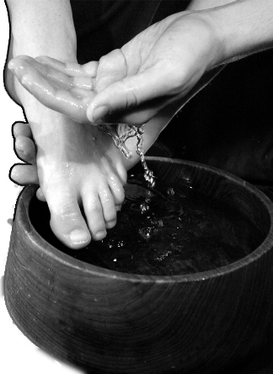
THE BIBLICAL MODEL OF SERVANT LEADERSHIP
Notes:
THE BIBLICAL MODEL OF SERVANT LEADERSHIP
Jesus led by being a servant to all and taught His disciples to imitate Him and lead in the same fashion. The most important occasion when Jesus modelled servant leadership for the disciples, and for us, was when He washed the feet of His twelve most intimate disciples. We will look closely at this biblical narrative.

Slide 20

THE FOUNDATION
…I am in the Father and the Father is in me
John 14:11
SECURITY
Notes:
THE FOUNDATION—SECURITY
Before we examine the washing of the disciples’ feet itself, it is important to realize that Jesus was only able to take the role of servant and perform this humble act because He was secure.
Jesus was secure in His relationship with God.
“. . . I am in the Father and the Father is in Me” —John 14:11

Slide 21

THE MOTIVATION
Having loved His own who were in the world, He loved them to the end.
John 13:1
LOVE
Notes:
THE MOTIVATION—LOVE
Why did Jesus wash His disciples’ feet? The most common answer is that He wanted to teach them a lesson about leadership. However, John tells us it that He did this as an expression of His love for them. Servant leaders serve others not from a sense of duty or to teach lessons, but out of genuine love.
Having loved His own who were in the world, He loved them to the end. —John 13:1

Slide 22
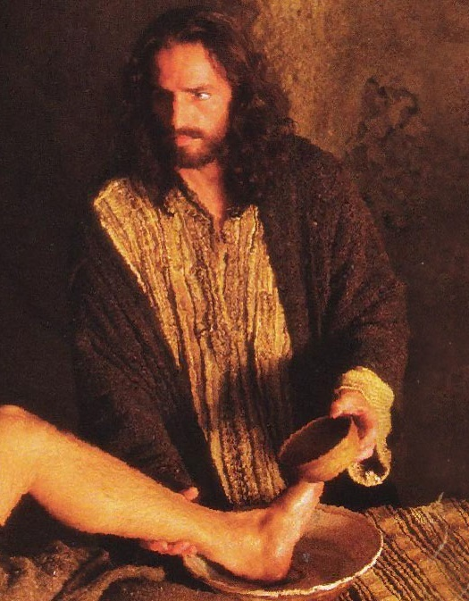
THE EXAMPLE
Jesus got up from the table, took off his outer robe, and tied a towel around himself. Then He poured water into a basin and began to wash the disciples’ feet and to wipe them with the towel that was tied around him. John 13:4-5
TRANSFORMATIONAL BEHAVIORS
Notes:
THE EXAMPLE—ACTION
Now we come to the actual event around the table in a Jerusalem dining room. Let us carefully examine the narrative.
[Jesus] got up from the table, took off His outer robe, and tied a towel around Himself. Then He poured water into a basin and began to wash the disciples’ feet and to wipe them with the towel that was tied around Him. —John 13:4–5, NRSV

Slide 23
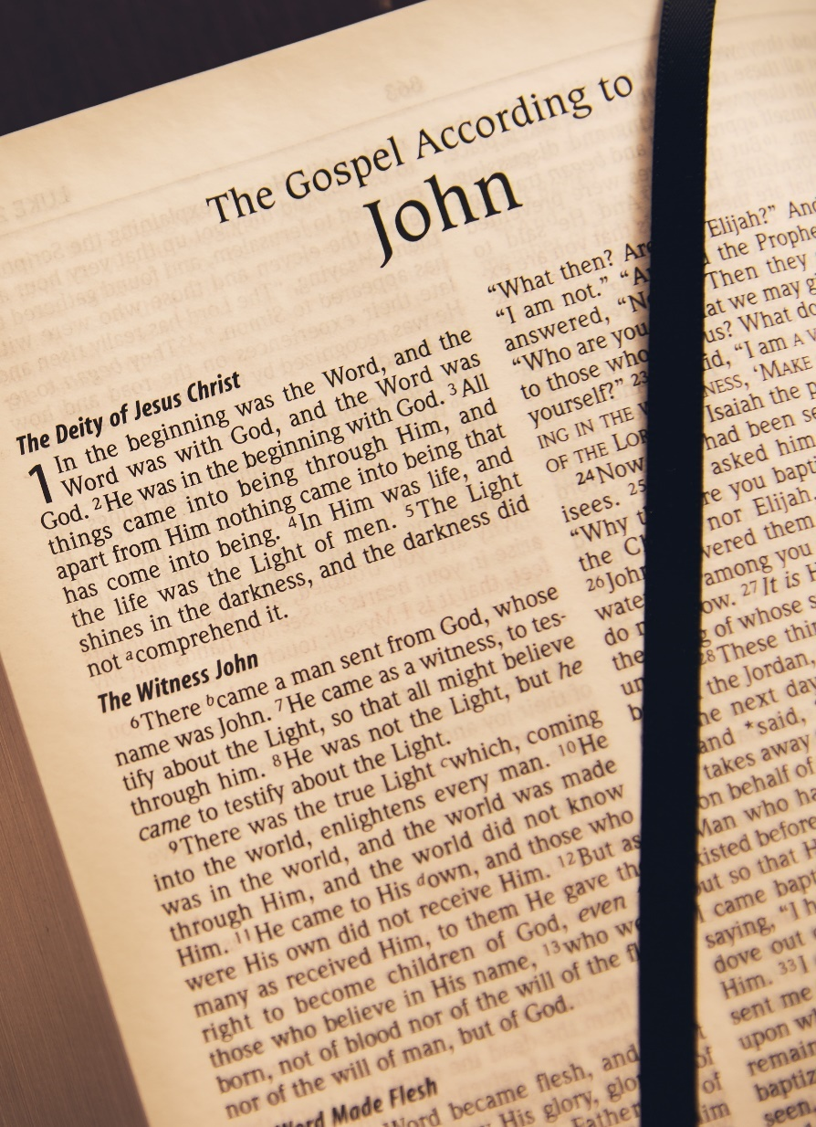
THE EXAMPLE
You call Me ‘Teacher’ and ‘Lord’ and rightly so, for that is what I am. Now that I, your Lord and Teacher, have washed your feet, you also should wash one another’s feet. I have set you an example that you should do as I have done for you.
John 13:13–15
TRANSFORMATIONAL BEHAVIORS
Notes:
THE EXAMPLE—ACTION
It is clear that Jesus takes the role of a house slave. The washing of feet was a humble act that only the lowest servants did. The Master’s action challenged the culture of the day and certainly shocked the disciples, as we can see by Peter’s initial reaction.
“You call Me ‘Teacher’ and ‘Lord’ and rightly so, for that is what I am. Now that I, your Lord and Teacher, have washed your feet, you also should wash one another’s feet. I have set you an example that you should do as I have done for you.”—John 13:13–15
Jesus was recognized as Master and Teacher. He knew this clearly, as did the disciples. Jesus’ action held greater significance than washing dirty feet. It was an attitude of serving when one was not required to do so.

Slide 24

Love is patient, love is
kind, and is not jealous;
love does not brag and is not arrogant, does not act unbecomingly; it does not seek its own, is not provoked, does not take into account a wrong suffered, …
THE POWER OF LOVE
Notes:
THE POWER OF LOVE
Jesus washed the disciples’ feet out of perfect love for them. The apostle Paul wrote to the Church in Corinth and powerfully described this kind of love.
Love is patient, love is kind, and is not jealous; love does not brag and is not arrogant, does not act unbecomingly; it does not seek its own, is not provoked, does not take into account a wrong suffered, does not rejoice in unrighteousness, but rejoices with the truth; bears all things, believes all things, hopes all things, endures all things. Love never fails. —1 Corinthians 13:4–8, NASB

Slide 25
…does not rejoice in
unrighteousness, but rejoices with the truth; bears all things, believes all things, hopes all things, endures
all things. Love never fails
1 Corinthians 13:4–8, NASB
THE POWER OF LOVE
Notes:
THE POWER OF LOVE
Jesus washed the disciples’ feet out of perfect love for them. The apostle Paul wrote to the Church in Corinth and powerfully described this kind of love.
Love is patient, love is kind, and is not jealous; love does not brag and is not arrogant, does not act unbecomingly; it does not seek its own, is not provoked, does not take into account a wrong suffered, does not rejoice in unrighteousness, but rejoices with the truth; bears all things, believes all things, hopes all things, endures all things. Love never fails. —1 Corinthians 13:4–8, NASB

Slide 26
THE POWER OF LOVE
is patient,
is kind, and is not jealous;
does not brag and is not arrogant,
does not act unbecomingly; he does not seek his own,
is not provoked,
does not take into account a wrong suffered, …
Notes:
WORKSHOP
To help us understand the full power of Christ’s love in servant leadership, let us read again the text of 1 Corinthians, but we will substitute the word “love” for “Christ.” These are also the practical qualities and characteristics required of a servant leader who is seeking to follow in the steps of Jesus.
Christ is patient; Christ is kind; He is not jealous.
Christ does not brag and is not arrogant.
Christ does not act unbecomingly; He does not seek His own.
Christ is not provoked, does not take into account a wrong suffered.
Christ does not rejoice in unrighteousness, but rejoices with the truth.
Christ bears all things; He believes all things, hopes all things, and endures all things.
Christ never fails.

Slide 27
THE POWER OF LOVE
… does not rejoice in unrighteousness, but rejoices with the truth;
bears all things,
believes all things, hopes all things, endures all things.
never fails.
1 Corinthians 13:4–8, NASB
Notes:
WORKSHOP (CONTINUED FROM LAST SLIDE)
Jesus’ words to the disciples were “do like I have done to you.” Read the text again, but this time, put your own name in the blank. Then reflect on what you just said. How do you measure up to the standard of Christ’s love?
is ; is kind is not jealous.
does not brag and is not arrogant.
does not act unbecomingly; does not seek own.
is not provoked, does not take into account a wrong suﬀered.
does not rejoice in unrighteousness, but rejoices with the truth.
bears all things; believes all things, hopes all things, and endures all things.
never fails.
As you said these words about yourself, perhaps you felt the conviction of the Holy Spirit that your life does not fully measure up to the standard of Christ’s example. We invite you to join ILI leaders around the world in asking God to transform our lives by the power of the Holy Spirit so our leadership would be marked by perfect love.

Slide 28
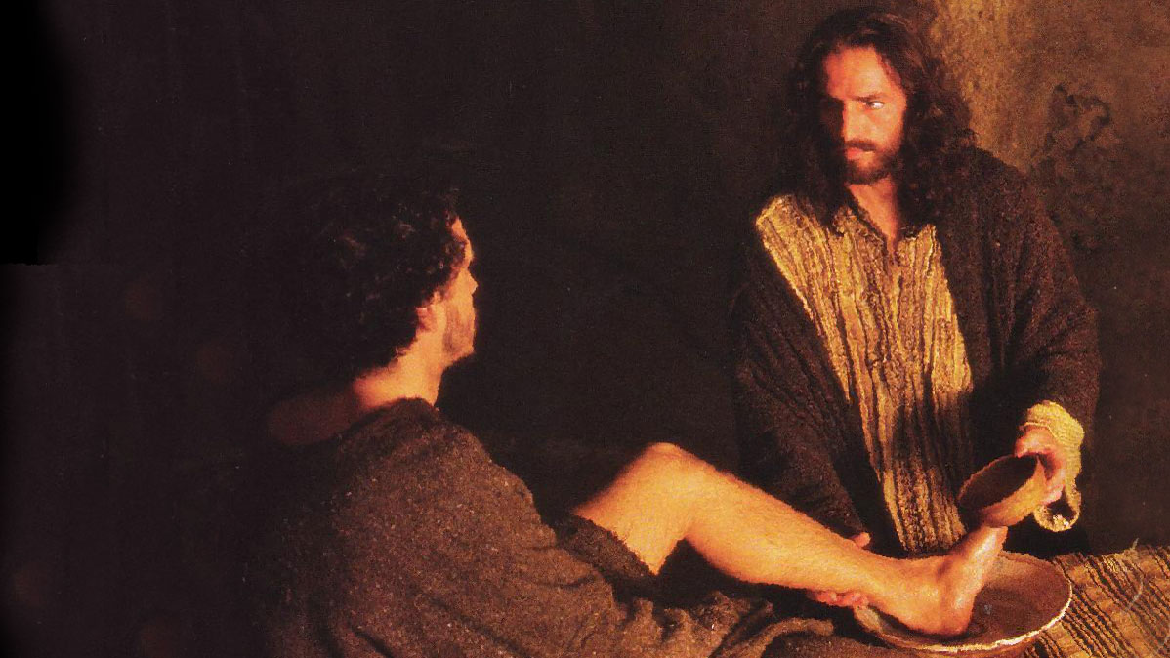
Notes:
EXPERIENTIAL LEARNING ACTIVITY
WASHING EACH OTHER’S FEET
NEEDED RESOURCES
This exercise can be done in two ways, depending on available resources and cultural particularities.
Option 1 - requires several hand or bath towels, basins or buckets big enough to fit a person’s foot, and water.
Option 2 - requires flannel clothes and/or shoe shining brushes.
INSTRUCTIONS:
When Christ washed the feet of the disciples in the upper room, He provided a supreme example of humility, compassion, and love in action. We suggest concluding the session on servant leadership with a practical exercise that exemplifies Christ’s attitude.
Option 1 - Instruct each participant to choose one colleague and prayerfully wash each other’s feet. Both persons doing this exercise should be of the same gender.
Option 2 - This can also be accomplished with only towels, without removing shoes. Each participant should wipe the shoes of another participant and pray for that person.
Option 3 - Coordinators may also choose some other expression of service as a practical example of serving others, using the appropriate materials available.

Slide 29
THE LEADERSHIP TRIANGLE

Slide 30

TRANSFORMATIONAL LEADERSHIP

Slide 31

LEADERS ARE AGENTS OF CHANGE
Notes:
LEADERS ARE AGENTS OF CHANGE
This first aspect of transformational leaders focuses on the leader’s activity in the world. Biblical leaders are called to bring significant change that is based on the Word of God to society.
JESUS—THE ULTIMATE CHANGE AGENT
In Matthew’s account, Jesus established from the beginning of His ministry that He was to bring significant and meaningful change by delivering what we now know as “The Sermon on the Mount.”

Slide 32

TRANSFORMING FOLLOWERS INTO
LEADERS
Notes:
TRANSFORMING FOLLOWERS INTO LEADERS
Transformational leadership is also related to the way leaders interact with followers within their team.

Slide 33

I have given you the example. Jesus
LEADERSHIP BY
EXAMPLE
Notes:
LEADERSHIP BY EXAMPLE
Transformational leaders lead by example. They demonstrate confidence in the vision. They show respect, trust, and confidence in the team, and they are persistent in pursuing the vision. When they give their all, transformational leaders encourage followers to do the same.
IN SCRIPTURE: Jesus provided you with the supreme demonstration of influencing by example when He washed the disciples’ feet.

Slide 34
THE LEADERSHIP TRIANGLE

