Slide 1

PASSION FOR
THE HARVEST
ADVANCING THE KINGDOM OF GOD

Slide 3

PASSION DEFINED
Notes:
.

Slide 4

BIBLICAL FOUNDATION
But if I say, “I will not mention Him or speak any more in His name,” His word is in my heart like a FIRE, a fire shut up in my bones. I am weary of holding it in; indeed, I cannot. JEREMIAH 20:9
PASSION IS FIRE

Slide 5

BIBLICAL FOUNDATION
Then they commanded them not to speak or teach at all in the Name of Jesus. But PETER and JOHN replied, “Which is right in God’s eyes: to listen to you, or to Him? You be the judges! As for us, we cannot help speaking about what we have seen and heard.” Acts 4:18-20
PASSION IS CONVICTION

Slide 6

BIBLICAL FOUNDATION
I [PAUL] have been crucified with Christ and I no longer live, but Christ lives in me. The life I live in the body, I live by faith in the Son of God, who loved me and gave Himself for me. Galatians 2:20
PASSION IS A CRUCIFIED LIFE

Slide 7

WORKSHOP
Can you identify with Jeremiah, Peter and John, or Paul?

Slide 8
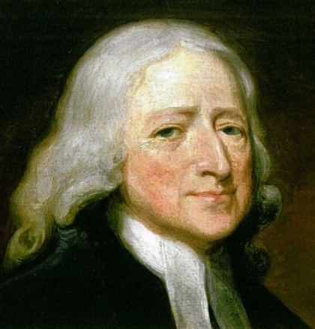
JOHN WESLEY
“Let us all be of one business”

Slide 9
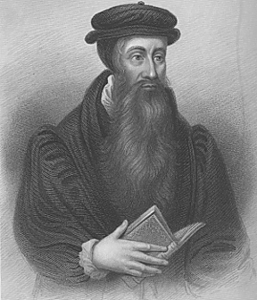
JOHN KNOX
“Lord, give me Scotland or I die”

Slide 10
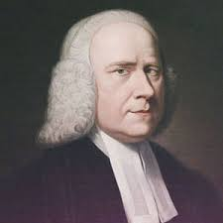
GEORGE
WHITEFIELD
“O Lord, give me souls or take my soul.”

Slide 11
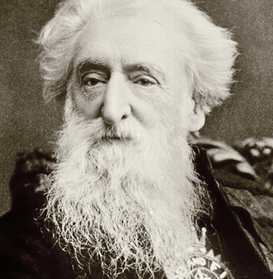
WILLIAM
BOOTH
“Sir, some men’s passion is for gold, other men’s passion is for fame, but my passion is for souls.”

Slide 12
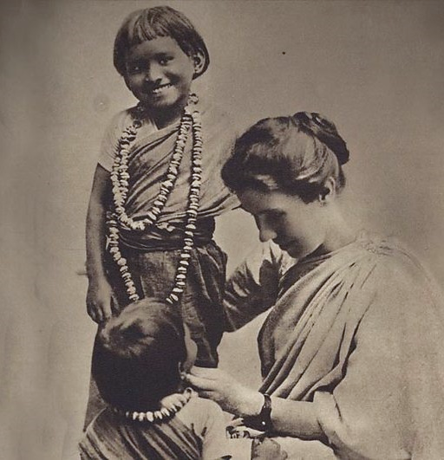
AMY
CARMICHAEL
“Don’t come if you haven’t made up your mind to live for one thing—the winning of souls.”

Slide 13
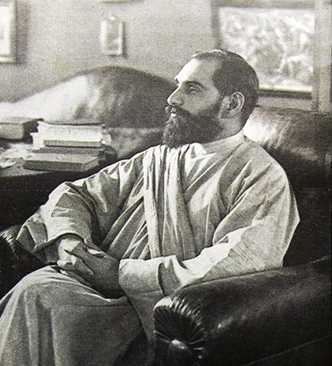
SADHU SUNDAR SINGH
“I am not worthy to follow in the steps of my Lord, but like Him, I want no home, no possessions. Like Him I will belong to the road, sharing the suffering of my people, eating with those who will give me shelter, and telling all people of the love of God.”

Slide 14
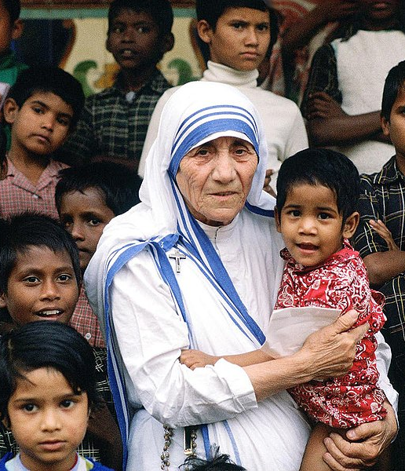
MOTHER
TERESA
“I desire to burn myself completely for Him and for souls.”
Notes:
⁷

Slide 15
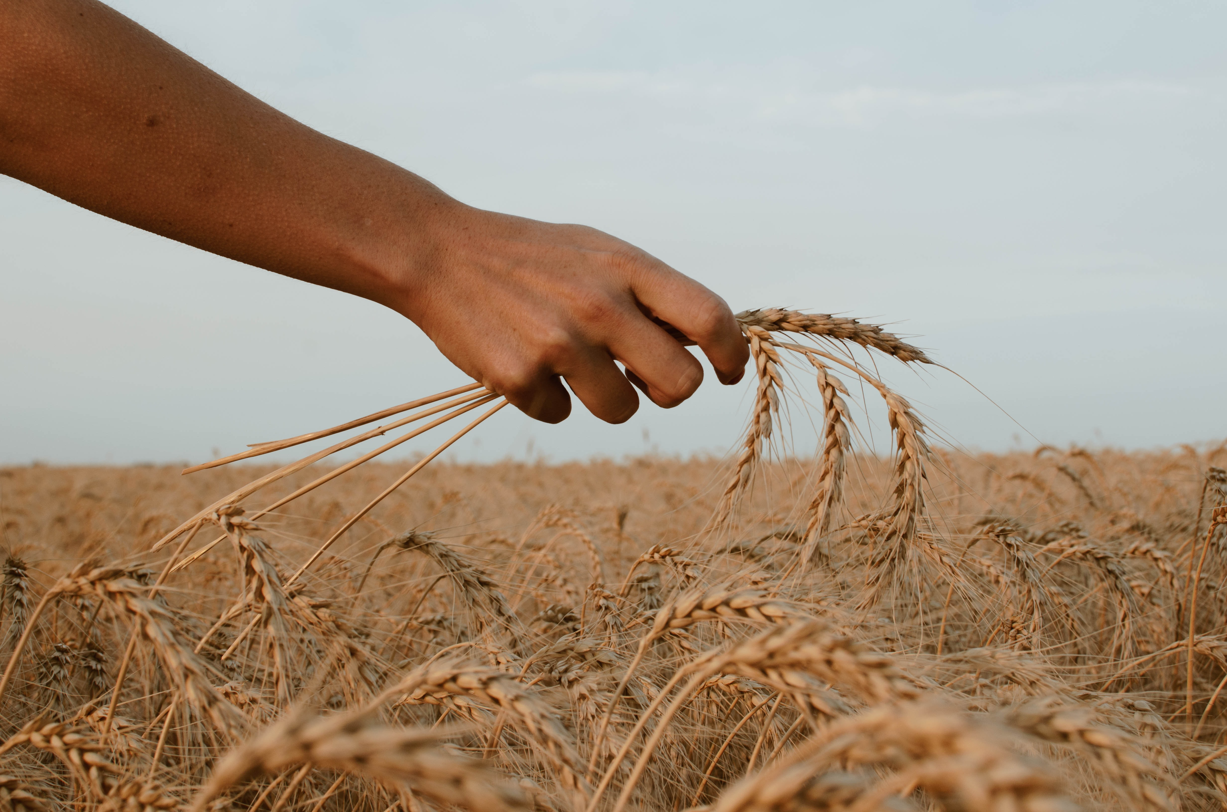
THE FIELDS ARE RIPE
Do you not say: “Four months and then the harvest?” I tell you open your eyes and look at the fields! They are ripe for harvest.
John 4:35

Slide 16
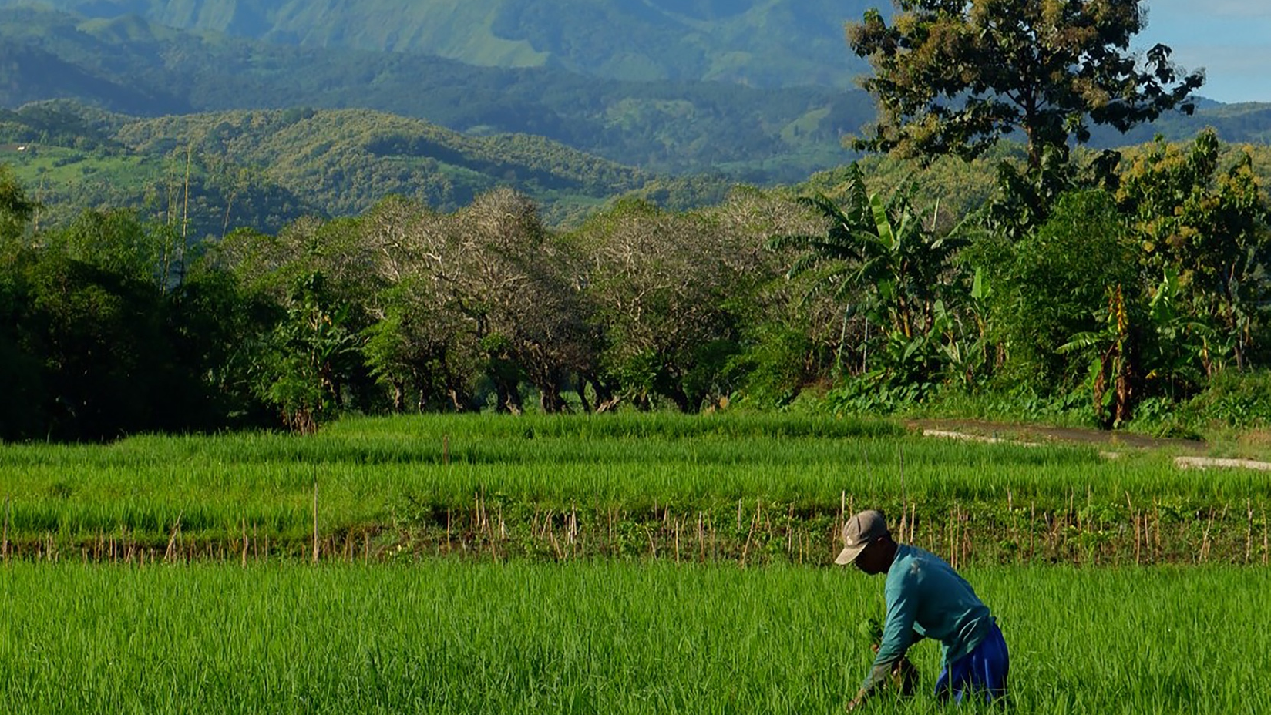
THE WORKERS
ARE FEW
When He [Jesus] saw the crowds, He had compassion on them, because they were harassed and helpless, like sheep without a shepherd. Then He said to His disciples, “The harvest is plentiful but the workers are few. Ask the Lord of the harvest, therefore, to send out workers into His harvest field.” Matthew 9:36–38
Photo by Amany Firdaus on Unsplash

Slide 17
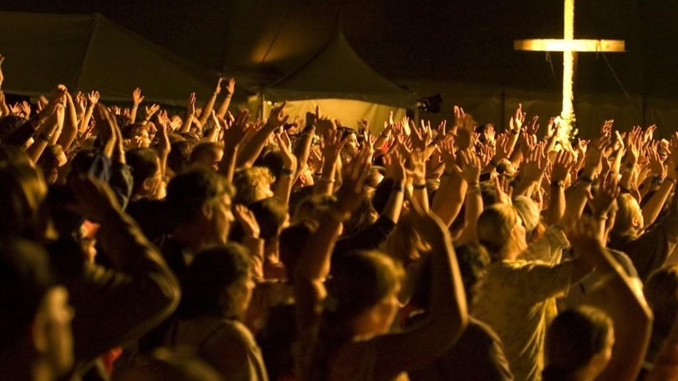
foto
Approximately 32% of the world says
THANK YOU
JESUS

Slide 18

28% of the world says
NO,
THANK YOU JESUS

Slide 19
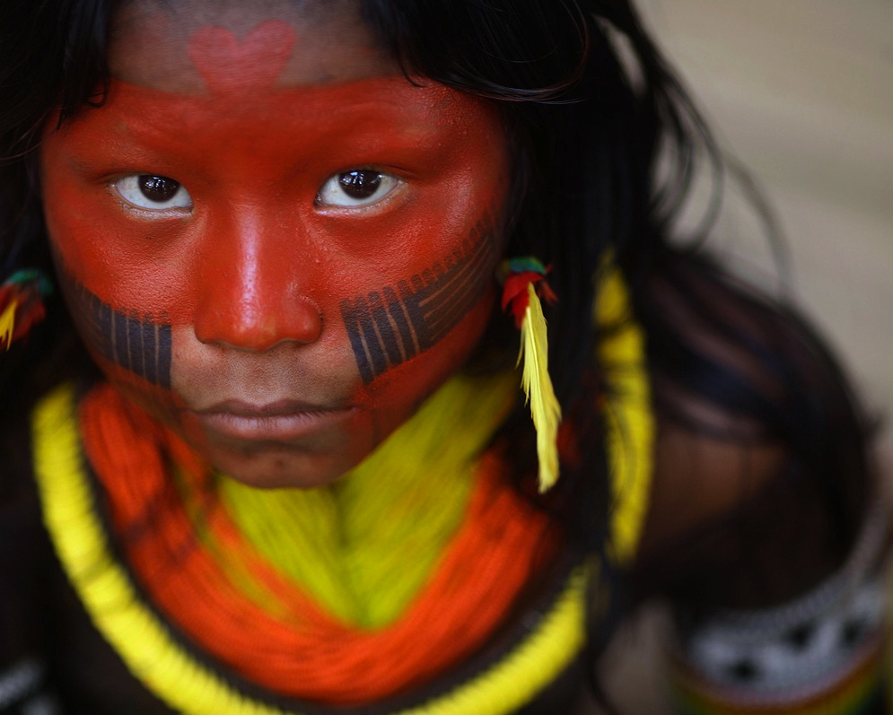
40% of the world says
WHO IS JESUS?

Slide 20
GLOBAL CHRISTIANITY
GROWTH
1900 - 2000

Slide 21

3 GREAT CHALLENGES

Slide 22
THE GOSPEL FOR EVERY PERSON
CHALLENGE 1:

Slide 23
A CHURCH FOR EVERY PEOPLE
CHALLENGE 2:
Notes:
.

Slide 24
THE GLOBAL CHURCH’S RESOURCES
99.7%
Maintaining the Church
0.3%
Expanding the
Reach of the Church

Slide 25
THE LEAST OF THESE
CHALLENGE 3:

Slide 26
THE LEAST OF THESE
For I was hungry and you gave me something to eat, I was thirsty and you gave me something to drink, I was a stranger and you invited me in, I needed clothes and you clothed me, I was sick and you looked after me, I was in prison and you came to visit me.

Slide 27
THE LEAST OF THESE
Then the righteous will answer him, ‘Lord, when did we see you hungry and feed You, or thirsty and give you something to drink? When did we see you a stranger and invite you in, or needing clothes and clothe you?

Slide 28
THE LEAST OF THESE
When did we see you sick or in prison and go to visit you?’ The King will reply, ‘Truly I tell You, whatever you did for one of the least of these brothers and sisters of mine, you did for me.’
Matthew 25:35-40

Slide 29

How do you think Jesus wants you to respond to the challenge of the current world situation?
THE LEAST OF THESE

Slide 30
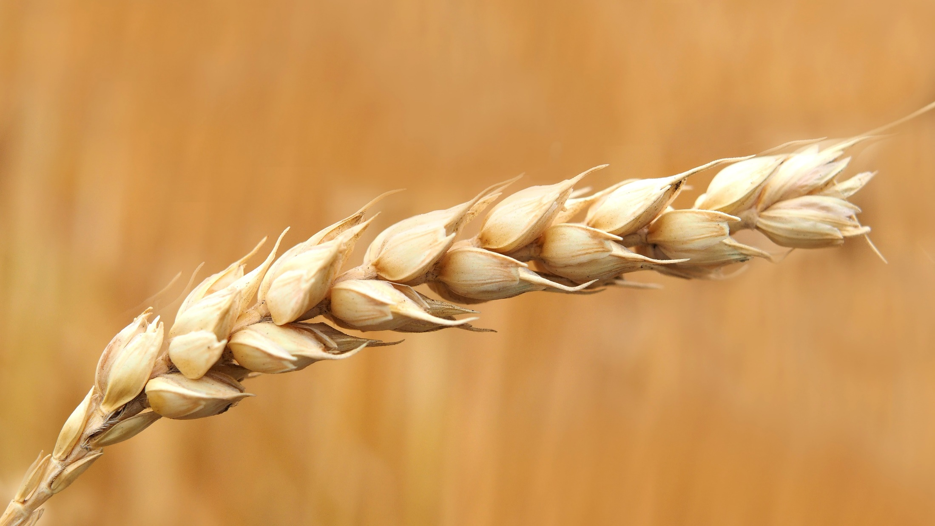
HOW TO FULLY EXPERIENCE
GOD’S PASSION

Slide 31
For Christ’s love compels us, because we are convinced that one died for all, and therefore all died. And he died for all, that those who live should no longer live for themselves but for him who died for them and was raised again. 2 Corinthians 5:14-15
HOW TO
FULLY EXPERIENCE

Slide 32
HOW TO FULLY EXPERIENCE
PASSION COMES FROM GOD
Every good and perfect gift is from above, coming down from the Father... James 1:17

Slide 33
Ask, and it will be given to you; seek and you will find; knock and the door will be open to you. For everyone who asks receives; he who seeks finds; and to him who knocks, the door will be opened.
Matthew 7:7-8
HOW TO FULLY EXPERIENCE
PASSION COMES FROM GOD

Slide 34

PASSION PRAYER

