Slide 1
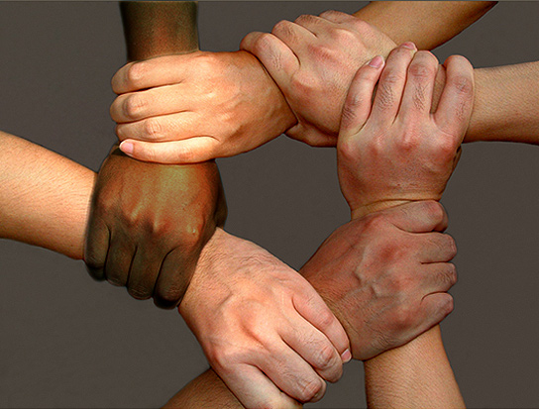
Advancing the
Kingdom of God
Discipleship

Slide 2
Biblical Command for
Making Disciples
Therefore go and make disciples of all nations, baptizing them in[a] the name of the Father and of the Son and of the Holy Spirit, and teaching them to obey everything I have commanded you.
Matthew 28:19-20:
Only One Imperative

Slide 3
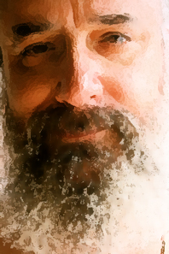
2 Timothy 2:2
Paul
And the things you have heard me say in the presence of many witnesses, entrust to reliable men who will be qualified to teach others.

Slide 4
Philippians 4:9
Keep putting into practice all you learned from me and heard from me and saw me doing….
Discipleship is focused on
Practical Application of Teaching

Slide 5

Definition of a Disciple
One who knows Christ inwardly and is committed to living outwardly in love and obedience to Him.

Slide 6
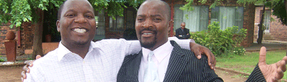
Definition of Discipleship
Helping other disciples grow to spiritual maturity by building the principles of God’s Word into a person’s life so he or she is equipped to understand and follow the promptings of the Holy Spirit in knowing how to respond to any situation with Christ-like attitudes and actions.

Slide 7
Jesus
Ministry to the crowd
Ministry to the 120
Taught and delegated authority to the 70
Invested personally in the 12 apostles
Special investment in Peter, James, John

Slide 8
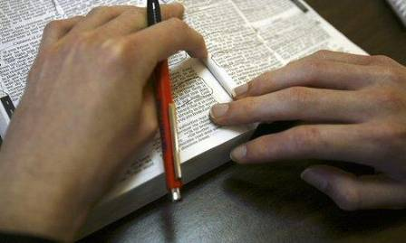
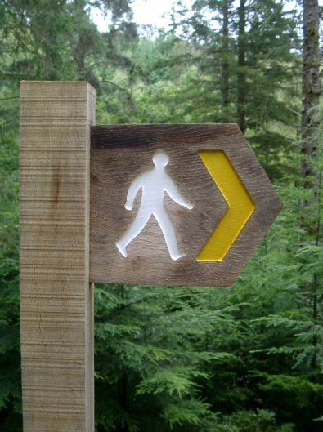
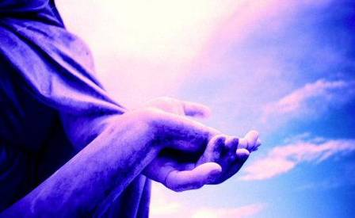
Primary Spiritual Disciplines
Prayer
God’s Word
Obedience
“A disciple is one who longs to obey and grow in these areas.”

Slide 9
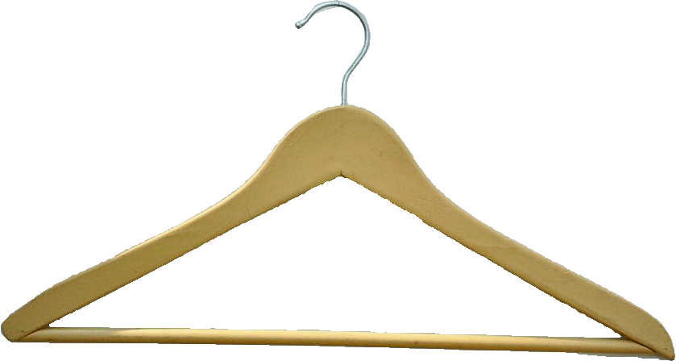
God
The Clothes Hanger
Discipleship Model
Intimacy
Prayer
Scriptures
The Disciple
Obedience

Slide 10
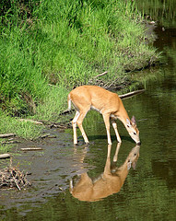
Prayer
Psalm 42:1-2
  As the deer pants after streams of water so my soul pants for you, O God. My souls thirsts for the living God. When can I go and meet with God.

Slide 11

A Good Handle on The Word of God
Scripture
Psalm 1:2-3
Psalms 119 9-11
Memorizing
Ezra 7:10
Meditating
Studying
Reading
Revelation 1:3
Hearing
Romans 10:17
Hand illustration: © Copyright The Navigators, Colorado Springs, CO USA. Used by Permission."

Slide 12

Obedience
  Deuteronomy 26:17-19
  “You have declared this day that the Lord is your God. You have promised to obey His laws, commands, and regulations by walking in His ways and doing everything He tells you…”

Slide 13

Workshop
Of the persons you have led to Christ, how many have you personally discipled?
If you haven’t done it, what were the reasons?
What decisions do you need to make in order for this first level of multiplication become a priority in your life?

