Slide 1

ХОРОШИЙ ФИНИШ
Продвижение Царства Божьего

Slide 2

ДЖОН СТИВЕН АКВАРИ
A FEW MORE DAYS
Notes:
INTRODUCTION
John Stephen Akhwari is an Olympic legend. Representing his country, Tanzania, he was a favorite to win the marathon at the 1968 Olympics in Mexico City. In the middle, of the race he suffered a fall, slicing open his knee and dislocating the joint.
He finally entered the stadium to complete the race, one hour after the winner crossed the finish line and the medalists received their awards. The last few spectators who were preparing to leave the stadium were witnesses to the historic event. Bloodied and bandaged, Akhwari hobbled around the stadium track and finished the race. When asked why he continued to race when he had no chance of a medal, his answer was:
“My country did not send me 5,000 miles to start the race;
they sent me 5,000 miles to finish the race.”

Slide 3
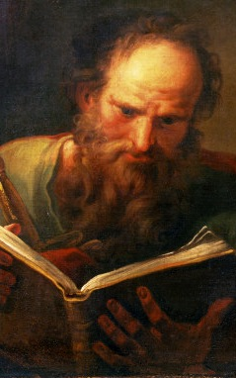
ПРАВИЛЬНО НАЧАЛ
Сразу же он начал проповедовать в синагогах, что Иисус есть Сын Божий.
Деяния 9:20-22
ПАВЕЛ
Notes:
GOD’S PLAN AND THE REALITY OF LIFE
There is no question in our minds that God’s plan for us is that we finish well. Paul is our example.
STARTED RIGHT
At once he began to preach in the synagogues that Jesus is the Son of God. Acts 9:20-22

Slide 4
ХОРОШО ЗАКОНЧИЛ
Подвигом добрым я подвизался, течение сохранил, веру сохранил.
2 Тимофею 4:7
Павел
Notes:
GOD’S PLAN AND THE REALITY OF LIFE
FINISHED WELL
I have fought the good fight, I have finished the race, I have kept the faith. 2 Timothy 4:7

Slide 5
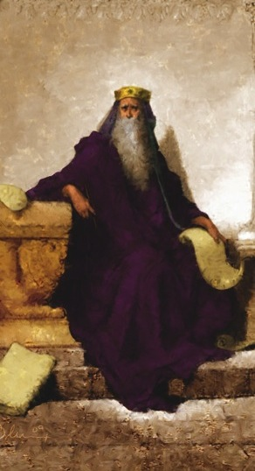
Правильно начал
Соломон показал свою любовь к Господу, поступая по уставам своего отца Давида.
1 Царств 3:3
СОЛОМОН
Notes:
GOD’S PLAN AND THE REALITY OF LIFE
God’s purpose for us has never been that we quit or give up. Solomon is the example of a leader who did not finish well.
STARTED RIGHT
Solomon showed his love for the Lord by walking according to the statutes of his father David. 1 Kings 3:3

Slide 6
ПЛОХО ЗАКОНЧИЛ
Когда Соломон состарился, жены его обратили сердце его к другим богам... и Соломон сделал зло в глазах Господа.
1 Царств 11:4-6
СОЛОМОН
PAUL
Notes:
GOD’S PLAN AND THE REALITY OF LIFE
FINISHED POORLY
As Solomon grew old, his wives turned his heart after other gods… so Solomon did evil in the eyes of the Lord. 1 Kings 11:4-6

Slide 7
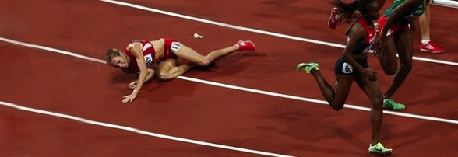
70%
НЕ ЗАКАНЧИВАЮТ ХОРОШО
Notes:
YET, the FACT IS…
70% of all leaders will not finish well.
Scholar and writer J. Robert Clinton researched Christian leaders and aﬃrms that seven out of ten leaders will not finish well. Clinton’s conclusion was gleaned from leaders’ personal assessment, peer and follower evaluation, or the teaching of their professed religion.1

Slide 8

ВЫБЫЛ ИЗ ИГРЫ
...ибо Димас, возлюбив мир сей, оставил меня и пошел в Фессалонику.
2 Тимофею 4:10
Notes:
WHERE DID THEY GO?
DROPPED OUT. 2 Timothy 4:10—“Demas . . . has deserted me.”

Slide 9

СТАЛИ ПЛОТСКИЕ
Их удел - разрушение, их бог - желудок, а их слава - в их позоре. Их мысли заняты земными вещами. Филиппийцам 3:19
Notes:
WHERE DID THEY GO?
PLATEAUED. Philippians 3:19b—“Their mind is on earthly things.”

Slide 10

ДИСКВАЛИФИЦИРОВАЛИСЬ
Ибо печаль ради Бога производит неизменное покаяние ко спасению, а печаль мирская производит смерть.
2 Коринфянам 7:10
Notes:
WHERE DID THEY GO?
DISQUALIFIED. 2 Corinthians 7:10—Worldly sorrow with no repentance.

Slide 11

КАК ЭТО ПРОИЗОШЛО?
Начало мудрости - страх Господень; глупцы только презирают мудрость и наставление.
Притчи 1:7
Notes:
HOW DID THIS HAPPEN? . . . ASK KING SOLOMON
King Solomon is a tragic, biblical example of someone who started right but did not finish well. He began as a “man of wisdom” who wrote,
The fear of the LORD is the beginning of knowledge, but fools despise wisdom and discipline. -Proverbs 1:7

Slide 12

КАК ЭТО ПРОИЗОШЛО?
"Суета сует, сказал Екклесиаст, суета сует, - все суета!
"Абсолютно Все бессмысленно".
Екклесиаст 1:2
Notes:
HOW DID THIS HAPPEN? . . . ASK KING SOLOMON
Later in his life, Solomon became a cynic and a fool who wrote,
“Meaningless! Meaningless!” says the Teacher. “Utterly meaningless! Everything is meaningless.” -Ecclesiastes 1:2

Slide 13

КАК МЫ ТЕРЯЕМ ЦЕЛОСТНОСТЬ?
ШАГ ЗА ШАГОМ
В
НЕПРАВИЛЬНОМ
НАПРАВЛЕНИИ
Notes:
HOW DO WE LOSE INTEGRITY? — ONE STEP AT A TIME
Seldom does just one factor or influence cause one to not finish well; rather, it is often just one step that starts us in a direction that, if not checked, would cause us not to finish well in life.

Slide 14


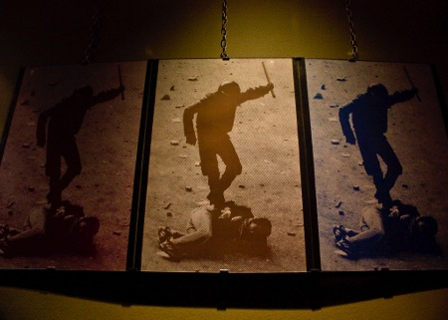

БОЛЬШАЯ ЧЕТВЕРКА
Notes:
THE BIG FOUR
MONEY, SEX, POWER, AND PRIDE
These first four factors are the most obvious and common reasons so many Christian leaders do not finish well. They are described in 1 John 2:15–16,
“Do not love the world or anything in the world. If anyone loves the world, love for the Father is not in them. For everything in the world—the lust of the flesh, the lust of the eyes and the pride of life—comes not from the Father but from the world.”

Slide 15

ДЕНЬГИ
Notes:
MONEY
Money is not inherently evil. It can be a blessing, but it is also a great source of temptation.
1 Timothy 6:10—“For the love of money is a root of all kinds of evil.”
2 Timothy 3:2—“Lovers of money, boastful, proud . . .”
GOD’S ANSWER
Seek first the Kingdom of God. (See Matthew 6:33)
PRACTICAL APPLICATION
If possible, do not handle your church, organization, or ministry’s money. If you have to do this, make sure to always have three witnesses present and take every precaution to avoid even the appearance of evil. Even on a personal level, make sure there is transparency in all financial dealings.

Slide 16

СЕКС
Notes:
SEX
Sex is a precious gift from God to be enjoyed between a man and woman in marriage. Deviation from God’s purpose results in disaster.
Proverbs 2:18—“Surely her house [adulterous woman] leads down to death.”
Ephesians 5:3—“But among you, there must not be even a hint of sexual immorality.“
GOD’S ANSWER
Approach the throne of grace and find help. (See Hebrews 4:14–16)
PRACTICAL APPLICATION
Take proactive steps to prevent risk of temptation. Avoid being alone with persons to whom you might become physically attracted. If you are married, discuss with your spouse what boundaries would be most helpful and appropriate. Install pornography filters in your internet devices.

Slide 17
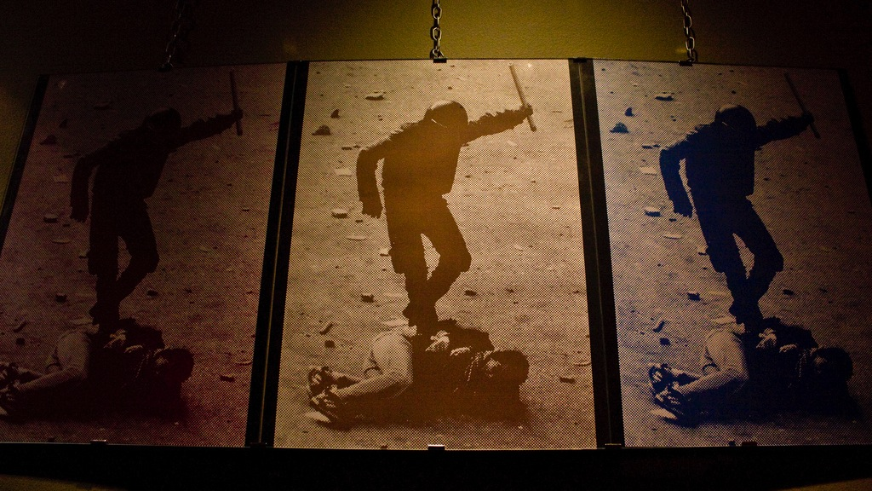
ВЛАСТЬ
Notes:
POWER
Power can be a great temptation for the leader. Leadership is influence and with it comes power. However, the abuse of power has serious consequences for the leader.
Acts 8:9–23— Simon, the Sorcerer, tried to use God’s power for personal benefit.
GOD’S ANSWER
Jesus never used power for His own benefit. (See Matthew 26:53)
PRACTICAL APPLICATION
Be a Christ-centered servant leader who focuses on building God’s Kingdom by helping others achieve their potential in Christ.

Slide 18

ГОРДОСТЬ
Notes:
PRIDE
Pride can be the result of success. Leaders who enjoy great success in ministry are prone to temptation in this area. However, the warning is clear:
Proverbs 16:18— “Pride goes before a fall.” Never say, what I have done.
GOD’S ANSWER
“Do nothing out of selfish ambition or vain conceit. Rather, in humility value others above yourselves.” — Philippians 2:3
PRACTICAL APPLICATION
Recognize often and publicly acknowledge the source of your success. At every opportunity, lift up the contribution of others as instrumental to any success. Follow a servant leadership model.

Slide 19
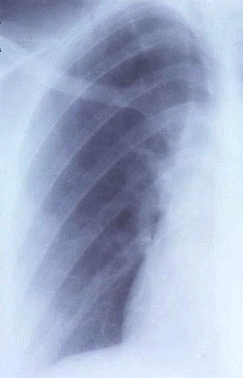
ПОДОБНО РАКУ
ЕЩЕ ЧЕТЫРЕ
Notes:
FOUR MORE
The four sins above are fairly obvious, although very dangerous. However, there are “four more.” These additional sins of the leader are like cancer and can be just as dangerous as the first four. These can be slow growing in influence in your life until it is almost too late to change.

Slide 20

ЕЩЕ ЧЕТЫРЕ
Посеянное в тернии означает слышащих слово,
но в которых заботы века сего, обольщение богатством и другие пожелания, входя в них, заглушают слово, и оно бывает без плода.
Марка 4:18-19
Notes:
This condition is described in Mark 4:13–19:
“Still others, like seed sown among thorns, hear the word; but the worries of this life, the deceitfulness of wealth and the desires for other things come in and choke the word, making it unfruitful.”

Slide 21

“Что было, то и будет; и что делалось, то и будет делаться, и нет ничего нового под солнцем.” Экклезиаст 1:9
УМСТВЕННЫЙ ЗАСТОЙ
Notes:
MENTAL STAGNATION
Solomon stopped listening to God and learning from God. Because of Solomon’s sin, he came to the point that he wrote the following words,
“What has been will be again, what has been done will be done again; there is nothing new under the sun.” — Ecclesiastes 1:9
GOD’S ANSWER
Keep learning.
Luke 2:52—Jesus grew in wisdom, stature, and grace.
Matthew 11:29—Jesus said, “Learn from Me”.
Proverbs 1:5 — “Let the wise listen and add to their learning.”
DO YOU HAVE PLANS FOR PERSONAL INTELLECTUAL GROWTH?

Slide 22

Во время старости ... сердце его не было вполне предано Господу Богу своему ...
И делал Соломон неугодное пред очами Господа и не вполне последовал Господу, как Давид, отец его. 3 Царств 11:4-6
ОСЛАБЛЕНИЕ ХАРАКТЕРА И УБЕЖДЕНИЙ
Notes:
CHARACTER AND CONVICTION
WEAKENING
As his kingdom prospered and Solomon made alliances with other nations, he began to put aside his convictions and his character faded. In the end, he was counted with the kings who did wrong in the eyes of the Lord.
As Solomon grew old . . . his heart was not fully devoted to the LORD . . . So Solomon did evil in the eyes of the LORD; he did not follow the LORD completely, as David his father had done. -1 Kings 11:4–6
GOD’S ANSWER
Aﬃrm your convictions and examine your character regularly.
Psalm 139:23–24—“Search me, O God, and know my heart.”
Acts 4:20—“We cannot help speaking about what we have seen and heard.”
Daniel 3:16-18—“We [three Hebrew young men] will not serve your gods or worship the image of gold you have set up.”
DO YOU INTERACT WITH AT LEAST ONE PERSON WHO WILL CONFRONT YOU ABOUT YOUR LIFE AND WITNESS?

Slide 23

“No one remembers the former generations, and even those yet to come will not be remembered by those who follow them.” Ecclesiastes 1:11
INFLUENCE & LEGACY NEGLECT
Notes:
INFLUENCE AND LEGACY NEGLECT
Later in his life, Solomon wrote Ecclesiastes, which is rather pessimistic about human life lived “under the sun.” In that book, Solomon cynically penned the following words:
“No one remembers the former generations, and even those yet to come will not be remembered by those who follow them.” —Ecclesiastes 1:11
Solomon actually neglected his legacy and his negative influence extended to his descendants. After his death, the kingdom was divided. His son and grandson who reigned after him were corrupt.
GOD’S ANSWER
Renew your commitments and realize your influence on future generations.
John 17:19—“For them I sanctify myself, that they too may be truly sanctified.”
Make God’s ultimate your ultimate—Transformed people who reliably reproduce the Christian life (2 Tim. 2:1–2).
ARE YOU INVESTING YOUR TIME IN A “TIMOTHY” TO HELP THAT PERSON BECOME A FAITHFUL DISCIPLE CAPABLE OF REPRODUCING HIM OR HERSELF IN OTHERS?

Slide 24

“The LORD became angry with Solomon because his heart had turned away from the LORD, the God of Israel, who had appeared to him twice.”
1 Kings 11:9
LOSS OF INTIMACY WITH GOD
Notes:
LOSS OF INTIMACY WITH GOD
Although he had powerful personal experiences with God in the beginning of his reign, towards the end of his life, Solomon abandoned Jehovah and followed other gods.
“The LORD became angry with Solomon because his heart had turned away from the LORD, the God of Israel, who had appeared to him twice.” —1 Kings 11:9
GOD’S ANSWER
Become more intentional about your personal and intimate relationship with God.
Psalm 27:4—“One thing I ask of the LORD, this is what I seek.”
Psalm 51:12—“Restore to me the joy of Your salvation.”
DO YOU HAVE A CONSISTENT DEVOTIONAL AND INTERCESSORY PRAYER TIME?

Slide 25

Есть ли какая-то область из "большой четверки", с которой вам нужно разобраться перед Богом?
Представляет ли какая-либо из "еще четырех" опасность в вашей жизни и руководстве?
Notes:
WORKSHOP
This is to be a time of personal reflection and self-examination. Prayerfully answer the questions below. You may want to set a personal (SMART) goal for your integrity.
Is there an area of the “big four” that you need to deal with before God?
Are any of the “four more” a danger in your life and leadership?

Slide 26

ВАША ЦЕЛЬ
ФИНИШНАЯ ЛИНИЯ
Notes:
YOUR GOAL IS THE FINISH LINE
Paul and many others have crossed it, and we can too. At the end of his life, Paul wrote the following powerful words to Timothy:
I have fought the good fight. I have finished the race. I have kept the faith.
—2 Timothy 4:7

Slide 27

КАК НАМ ФИНИШИРОВАТЬ ХОРОШО?
ШАГ ЗА ШАГОМ
3
ОБЯЗАТЕЛЬСТВА
Notes:
HOW DO WE FINISH WELL? ONE STEP AT A TIME
Like Paul and many others, we shall finish well if we make the following three simple commitments in our lives. They are the same commitments we saw in the Integrity session, but they are worth repeating and reinforcing in our lives.

Slide 28

ЦЕЛОСТНОСТЬ
ОБЯЗАТЕЛЬСТВО 1
Notes:
INTEGRITY
The first step to finishing well is an awareness of the absolute necessity of integrity in our lives and a personal commitment to live it. Integrity is as simple as keeping your promises and being a person who can be trusted. It means to be whole, complete, integrated.
Practical Application: Make a commitment today to live the values of Christianity with consistency in every area of your life, regardless of the circumstances.

Slide 29

ПОДОТЧЕТНОСТЬ
ОБЯЗАТЕЛЬСТВО 2
Notes:
ACCOUNTABILITY
To be held accountable means to be responsible for our attitudes, decisions, and actions (1 Tim. 4:16). Accountability is the practical weapon in the integrity war, without which we are unlikely to win.
As iron sharpens iron, so one person sharpens another. —Proverbs 27:17
Practical Application: Watch your life and doctrine closely. Select two or three persons whom you trust and who love and respect you, and share your commitment to integrity with them. Allow them to hold you accountable for your goal of finishing well, and have them help you honor that commitment.

Slide 30

ФОКУС
ОБЯЗАТЕЛЬСТВО 3
Notes:
FOCUS
Focus is an intentional act. Those who finish well like Paul have one focus in life, as the writer of Hebrews states,
Let us throw off everything that hinders and the sin that so easily entangles. And let us run with perseverance the race marked out for us, fixing our eyes on Jesus, the pioneer and perfecter of faith. For the joy set before Him He endured the cross, scorning its shame, and sat down at the right hand of the throne of God. —Hebrews 12:1–2
Practical Application: Imagine the end of your life years from now. Set the goal of finishing with more passion for God and His Kingdom than you have today. You may want to write down that goal and post it in a visible place.

Slide 31

МОЛИТВА ЗАВЕРШИТЕЛЯ
Notes:
CONCLUSION:
THE PRAYER OF THE FINISHER
In Acts 20, the apostle Paul addressed the elders of the Church at Ephesus that being “compelled by the Spirit,” he was on his way to Jerusalem. He confessed he did not know what his future would hold for him, except that “the Holy Spirit warns me that prison and hardships are facing me” in every city (verse 23). Paul then makes a profound statement that is also the prayer of every Christian who desires to finish well the race of the Christian life.

Slide 32
“Но я ни на что не взираю и не дорожу своею жизнью, только бы с радостью совершить поприще мое и служение, которое я принял от Господа Иисуса, проповедать Евангелие благодати Божией.”
— Деяния 20:24
Notes:
“I consider my life worth nothing to me; my only aim is to finish the race and complete the task the Lord Jesus has given me—the task of testifying to the good news of God’s grace.” —Acts 20:24

